Slide 1
A self-driving car simulation system

Slide 2
What is a self-driving car simulation system?
An autonomous car can go anywhere a traditional car goes and do everything that an experienced human driver does.
Self-driving vehicles are cars or trucks in which human drivers are never required to take control to safely operate the vehicle. Also known as autonomous or “driverless” cars, they combine sensors and software to control, navigate, and drive the vehicle. But before it is tested on roads, we run the simulation on the computer. This is known as self-driving car simulation system.
Though still in its infancy, self-driving technology is becoming increasingly common and could radically transform our transportation system.

Slide 3
Problem Statement
To develop a self-driving car system using Convolutional Neural Networks. The project purpose is to train a convolutional neural network to drive an autonomous car on the tracks of Udacity’s Car Simulator environment.
To generalize the model by training the model on one track and testing it on another unforeseen track.

Slide 4
Our project as a solution
Udacity committed to building an open source self-driving car simulator as part of its effort to offer its self-driving car nanodegree program.
The Udacity simulator allows you can steer a car around a track for data collection. The driving simulator would save frames from three front-facing “cameras”, recording data from the car’s point of view; as well as various driving statistics like throttle, speed, and steering angle.
We use image data and steering angles to train a neural network and then use this model to drive the car autonomously around the track. We trained a convolutional neural network (CNN)

Slide 5
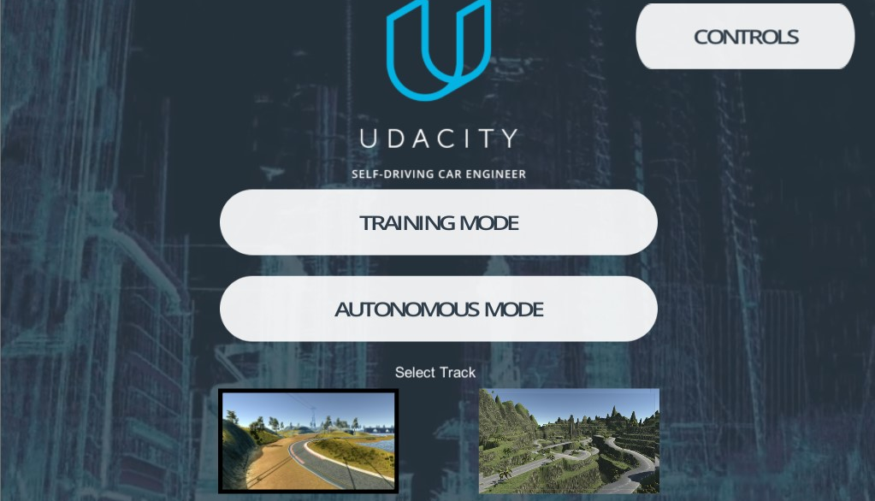
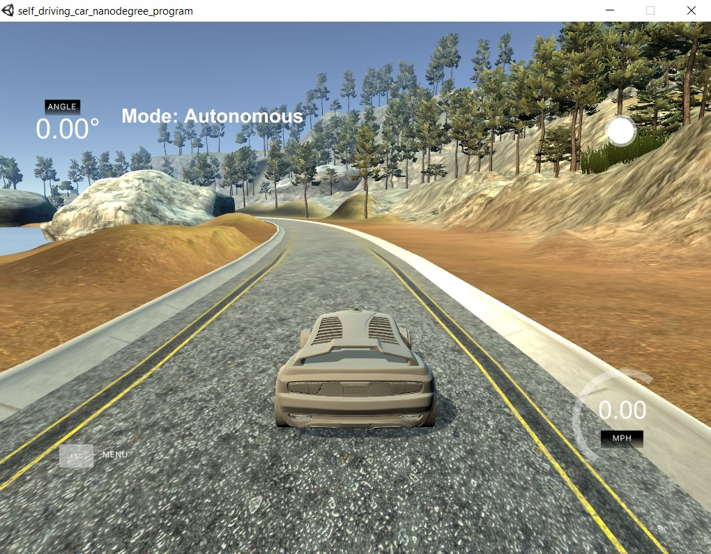
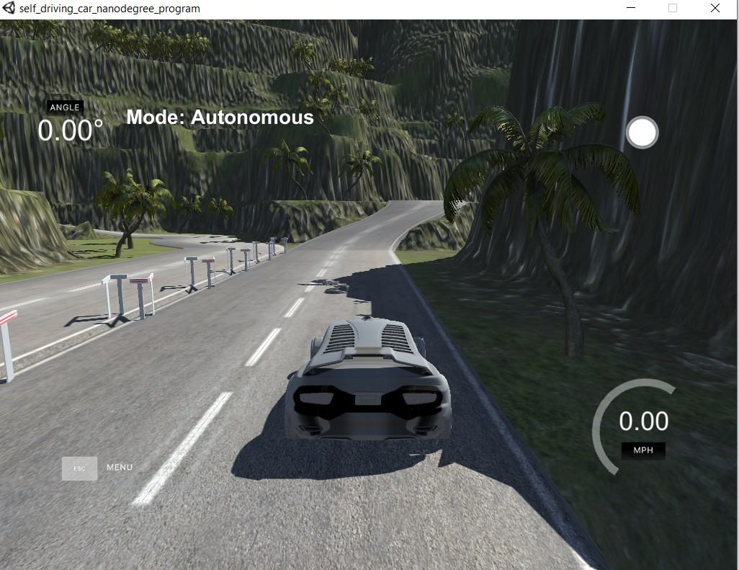
Udacity’s simulator

Slide 6
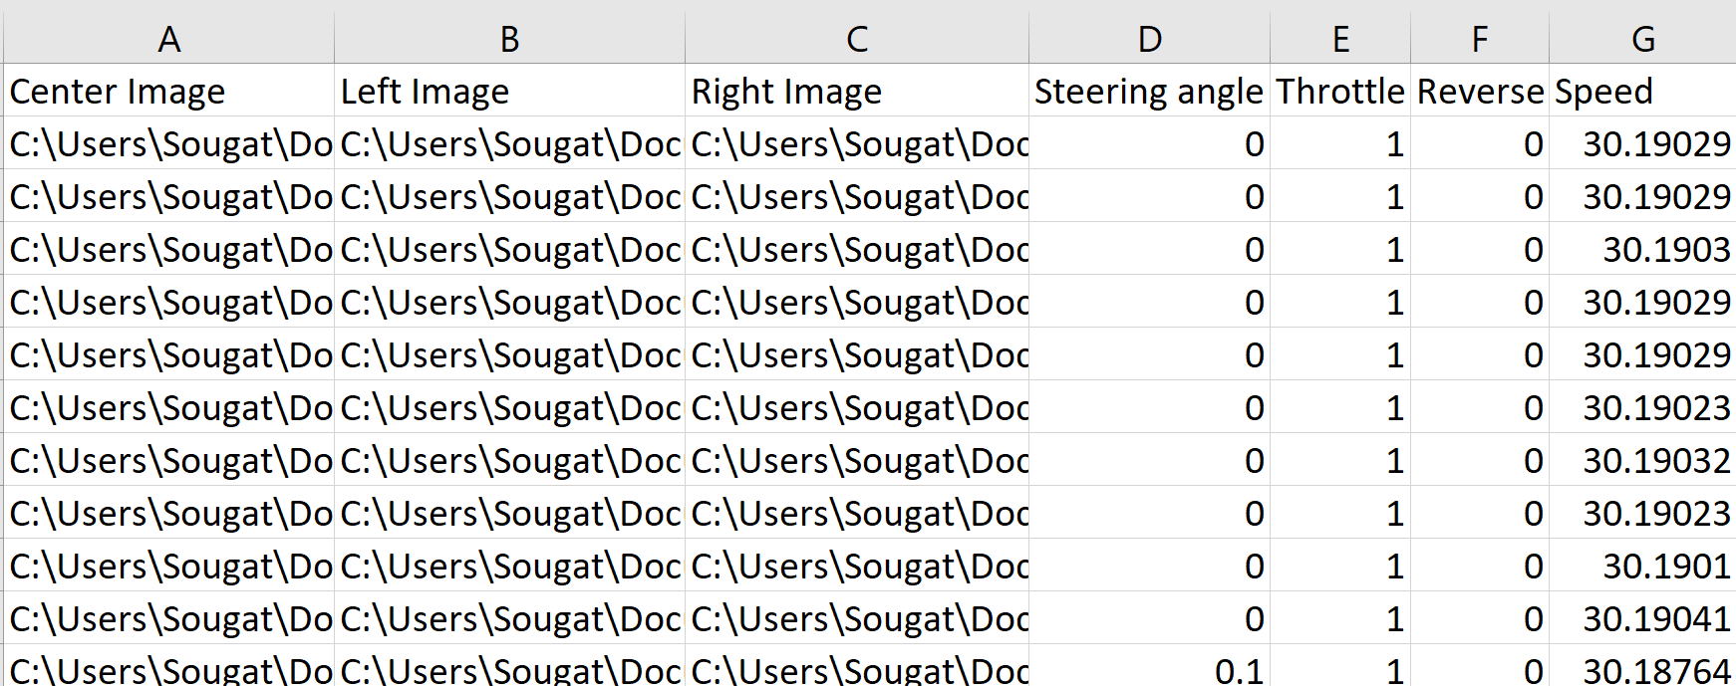
Dataset

Slide 7
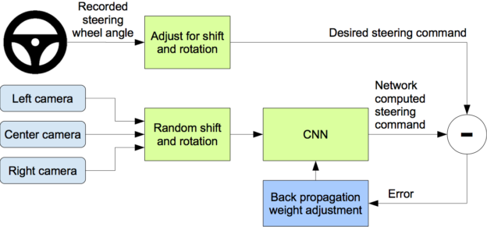
Block Representation of our Model Training System

Slide 8
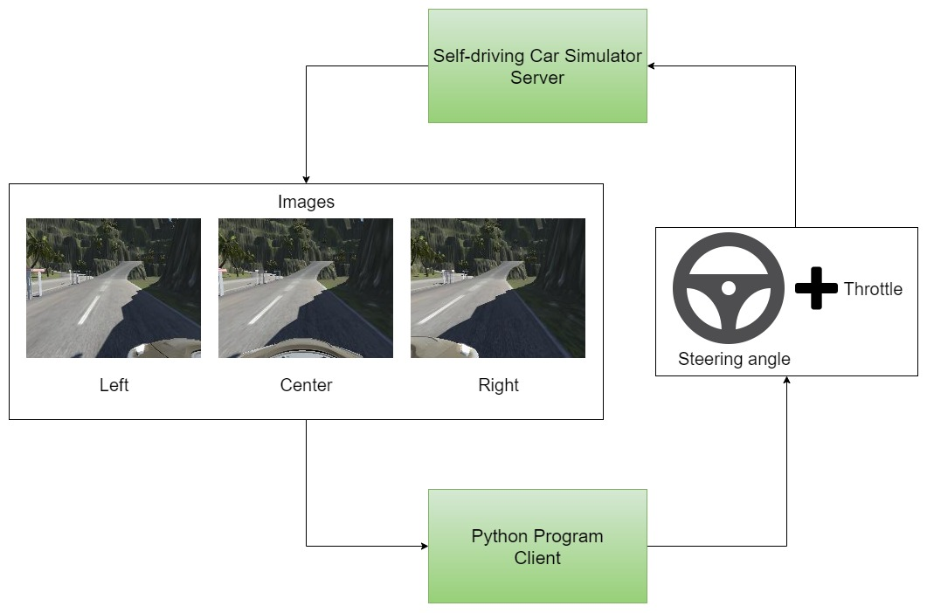
Block Representation of our Autonomous Driving System
throttle = 1.0 - steering_angle**2 - (speed/speed_limit)**2

Slide 9
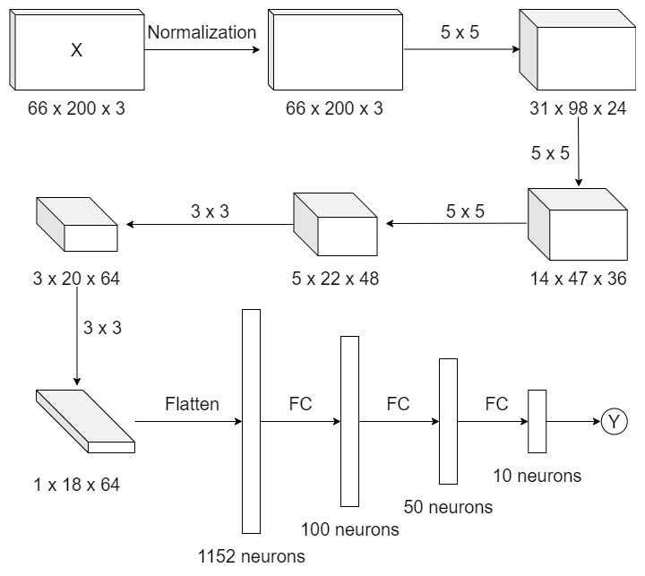
Our NN Model
structure

Slide 10
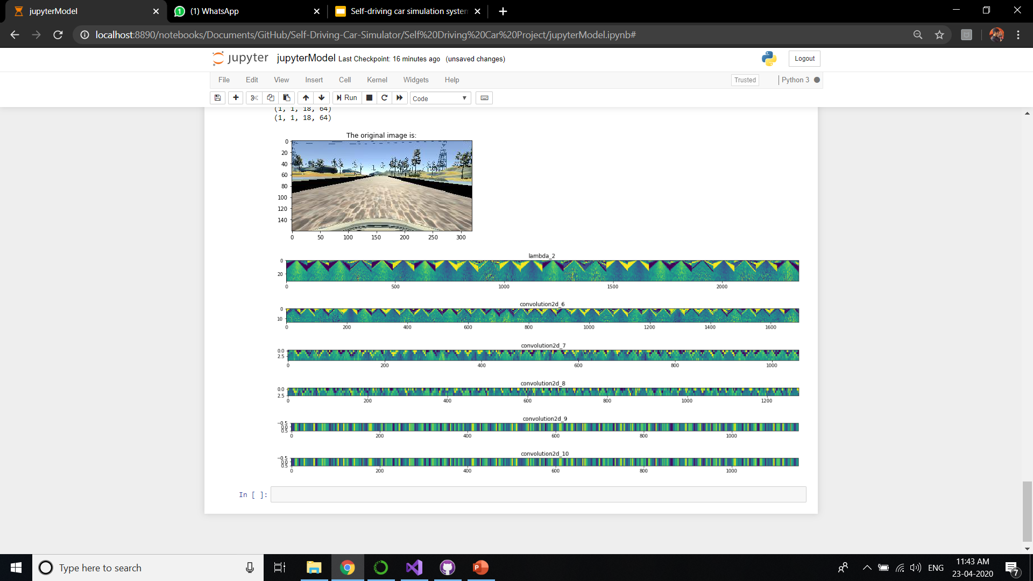
Visualization of the effect of our Convolutional layers on the input image

Slide 11
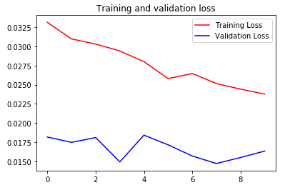
Visualization of loss function for 10 epochs

Slide 12
Conclusions/Results
The system is able to predict the steering of the car with a good accuracy.
On higher max speed limit, the car is not able to react fast enough to its environment.
The model is generalized well as the system is able to drive the car even on the unseen track quite well.
Constraint: The system has to be trained on the track with higher level features and it can be run to predict the values for the track with unforeseen but lower level features. Vice versa results in improper driving of the car on the unforeseen track.

Slide 13
THANKYOU!

